Slide 1

Vincent Lau, Victoria Cai, Xin Chao Chen, Mrunal Athaley, Siyan Zuhayer

Slide 2

TABLE OF CONTENTS
Summary
What is RPI Events
Users
Stakeholders
Requirements
Technology Summary
Functional Requirements
Non-Functional Requirements
Planning Phase
Estimated Project Schedule
Site Map
Wireframes

Slide 3

What is RPI Events?
RPI Events is a hub for all events at RPI 😱
View all events happening on campus
Post events that your club/organization is hosting

Slide 4



Users
RPI Club Officers:
Promote events hosted by their club.
Avoid potential conflicts with other clubs.
RPI Students:
Attend events hosted by various clubs.
Schedule their week more effectively.
RPI Faculty and Staff:
Host and promote events such as career fairs and workshops.
RPI Parents:
Stay informed about school activities and events.

Slide 5
Stakeholders
RPI Students
More opportunities to socialize and learn
An easy way to know what's going on
A resource to help time management
Event Hosters
Will have a better ideas about how many people will attend their event, which helps them to make necessary changes
Clubs and Teams
Good for advertising their club/team so that more people know about it and maybe join
Helpful to avoid conflicts with other events of similar interest
Professors/Faculty and Staff
Can use this tool to promote a workshop and etc.
Can use this to promote a combined type of office hours

Slide 6









Technology Summary
HTML, CSS, JavaScript
jQuery
Bootstrap
React/Angular
Node.js
Express.js
mongoDB
Shibboleth/OAuth
Nylas Calendar API
Notes:
For our frontend, we'll be using HTML/CSS/JS along with Bootstrap to help with styling and jQuery to interact with the DOM. We will use one of React and Angular to make all the components of our website, Node.js and Express.js for the backend and API, and mongoDB for our database. We will also use RPI Shibboleth or OAuth, whichever we're supposed to use, for letting users login and Nylas Calendar API for viewing events users have signed up for.

Slide 7
Functional Requirements
Login system
Event creation / sign-up forms
Dashboard
All events page
User feed
Events API
Notes:
For our functional requirements, we will have a login system to make sure only users can sign up for and create events. We will need to make separate event create and sign up forms for that. We will have a dashboard where users can view events they've signed up for or made. We will have an events page where all the events happening at RPI will be viewable. Along with that, there will be a user feed to personalize events to the user. We will also have an events API to allow developers to get data about events happening at RPI.

Slide 8
Non-functional Requirements
RPI login
Event organizer roles and authentication
Internal/external event sign-up
Event tags
Events calendar
Notes:
For our non-functional requirements, we will need to restrict our login system to only RPI students and staff which will be done using Shibboleth or OAuth. To make sure that our page doesn't get filled with fake events, we will have an event organizer role so that only users with that role can create events. We will need to authenticate users who request for the role, so we will likely have a request form for the role where users can fill out information about their organization that we can then verify ourselves. Since some events have sign-up forms on Google forms or Handshake or something else, we will allow for event organizers to decide whether they want to use our sign-up form or an external one. When users view events, they will be able to sort through them by a tag describing the event, such as clubs, careers, or sports. Once users have signed up for events, they will be able to view them on their dashboard on a calendar which will be made with Nylas Calendar API.

Slide 9

Estimated Project Schedule
January
Brainstorming and Identify Key Features
Project Proposal
February
Initiate Coding for the Web App Interface
Develop Initial Versions of Key Pages: Index, login, Home, etc.
Complete Front-End Development to Achieve a Functional Interface
Implement Additional Pages for Enhanced User-Friendliness
Begin Back-End Development
March
Develop Necessary APIs
Set Up MongoDB Database and Establish Backend Connections
Work on the Calendar Dashboard for accurate event display
Implement Features for Organizers
Create Endpoints for user registration, login, and profile management
April
Implement Other Features like Notification System for Event Updates and Dynamic User Feed With Relevant Event Suggestions
Testing of Backend Components and Addressing Bugs and Issues
Prepare for the Final Presentation

Slide 10
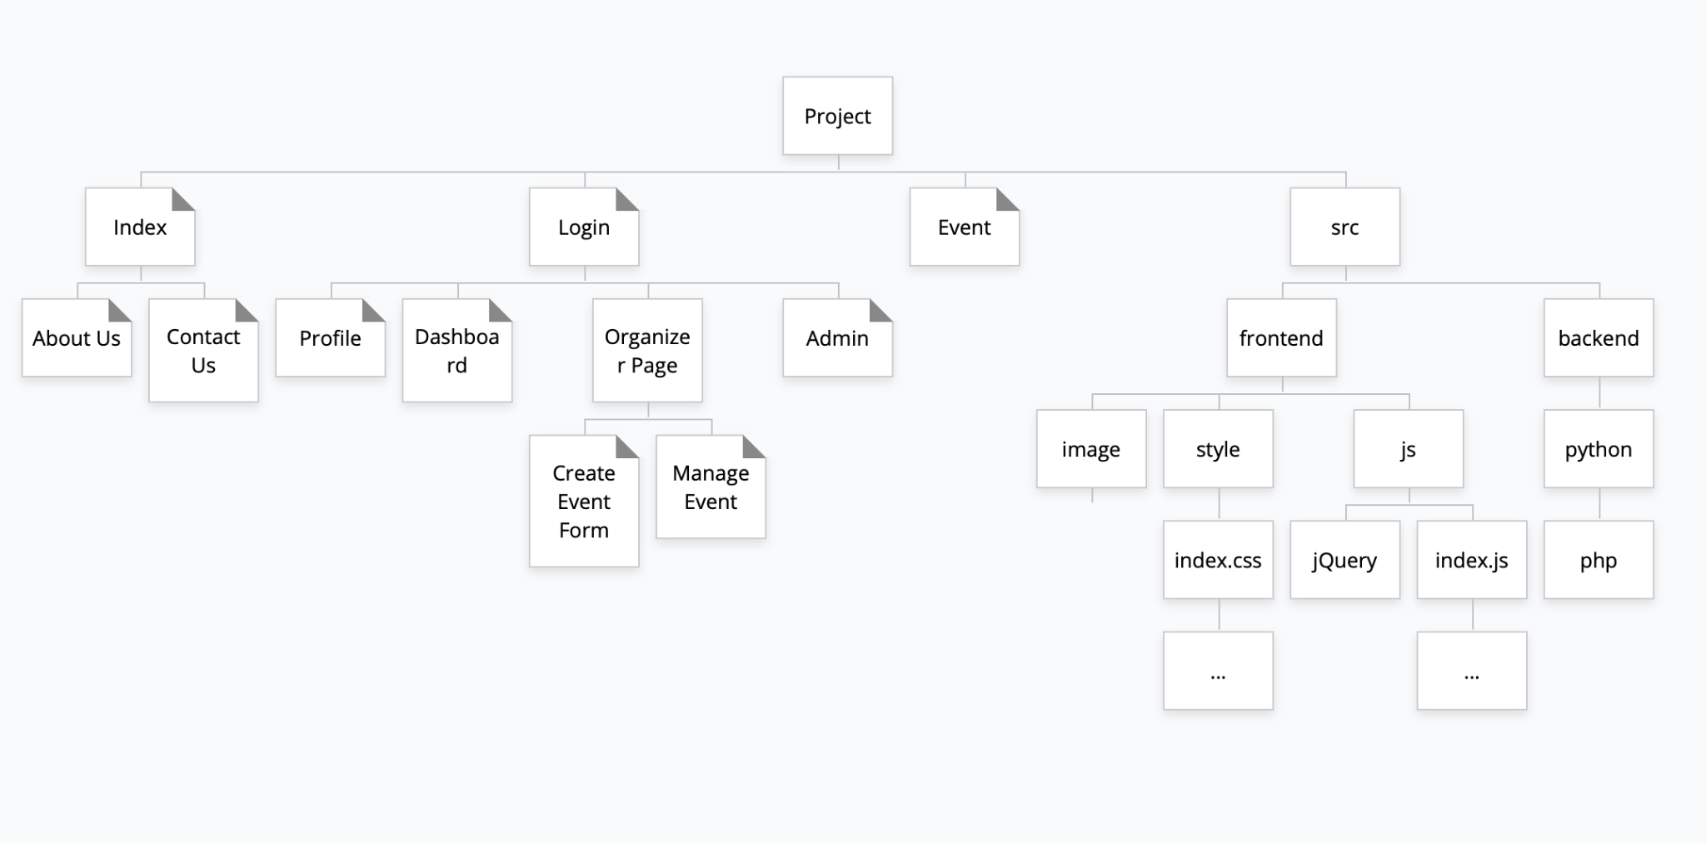
Site Map

Slide 11
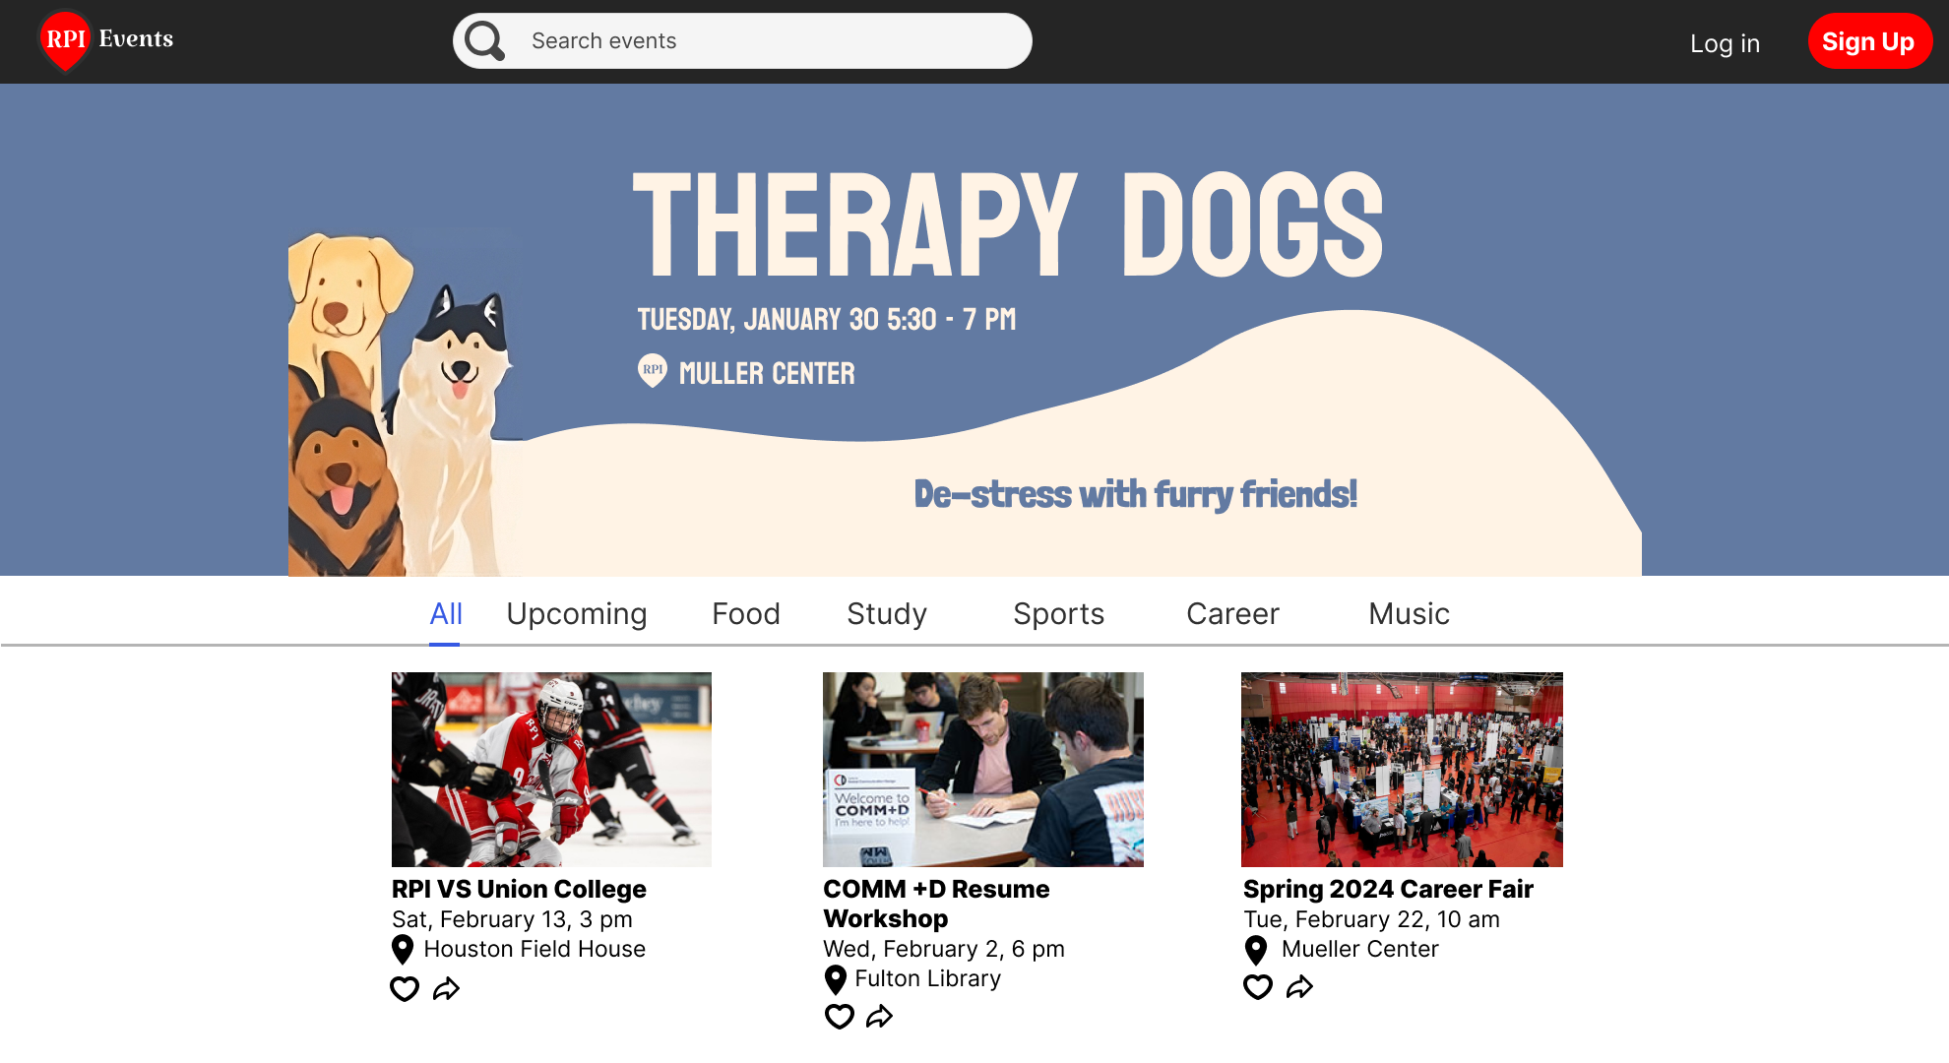
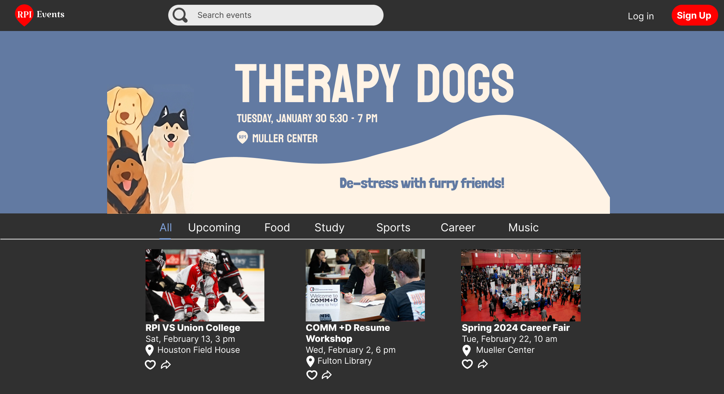
Wireframes

Slide 12
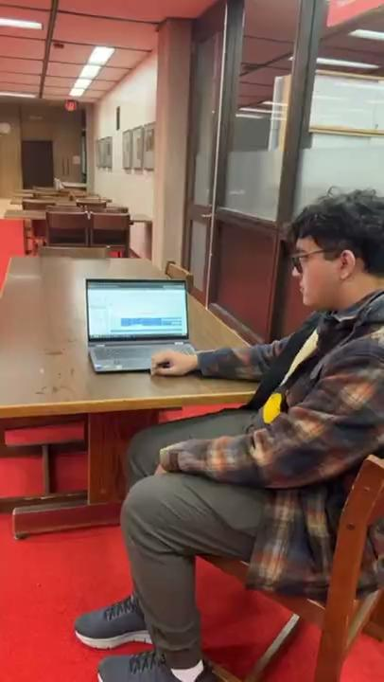
Instagram Video

Slide 13
THANKS!
What questions do you have?

Slide 14
Image Sources
https://en.m.wikipedia.org/wiki/File:HTML5_logo_and_wordmark.svg
https://en.wikipedia.org/wiki/CSS
https://theicom.org/js-logo/
https://en.m.wikipedia.org/wiki/File:React-icon.svg
https://en.wikipedia.org/wiki/File:Angular_full_color_logo.svg
https://marketplace.visualstudio.com/items?itemName=AnbuselvanRocky.bootstrap5-vscode
https://en.m.wikipedia.org/wiki/File:MongoDB_Logo.svg
https://en.wikipedia.org/wiki/File:Node.js_logo.svg
https://www.nylas.com/blog/best-calendar-apis/
DALLE generate image for Table of Contents, Stakeholders, User

